Slide 1
Shark tank india
Analysing
Using Multiple Regression

Slide 2
INdex
Text
Problem Statement
Domain Theory
Data Description
Data Cleaning
Data Implementation
Data Analysis
Conclusion

Slide 3
Are the investments made in particular sectors in shark tank India based on the GDP Growth of those sectors?

Slide 4
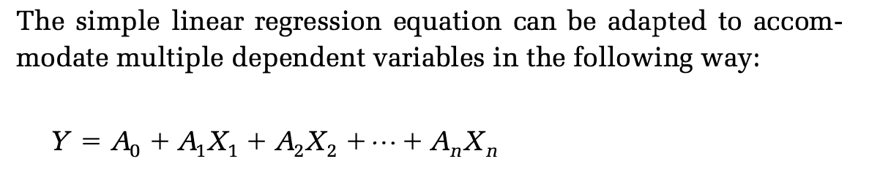
Multiple Regression
Text
When two or more dependent (X) variables are required for a prediction the analysis is referred to as multiple linear regression.
Theoretically there is no limit to the number of independent vari- ables that can be analysed, but within the spreadsheet the maxi- mum is 75. This is a far greater number than would ever actually be required in a business situation.

Slide 5
R, R square, Adjusted R and Predicted r
Text
R is the correlation between the predicted values and the observed values of Y.
R square is the square of this coefficient and indicates the percentage of variation explained by your regression line out of the total variation.
This value tends to increase as you include additional predictors in the model. Thus, one can artificially get higher R square by increasing the number of Xs in the model. To penalize this effect, adjusted R square is used.
When you compare models with their complexity, you should then rely on Adj R square.
Predicted R square is another measure which addresses the issue of overfitting the data and explain the prediction power for future observations.

Slide 6
Significance
Text
A significance level of 0.05 indicates a 5% risk of concluding that an association exists when there is no actual association. If the p-value is less than or equal to the significance level, you can conclude that there is a statistically significant association between the response variable and the term.

Slide 7
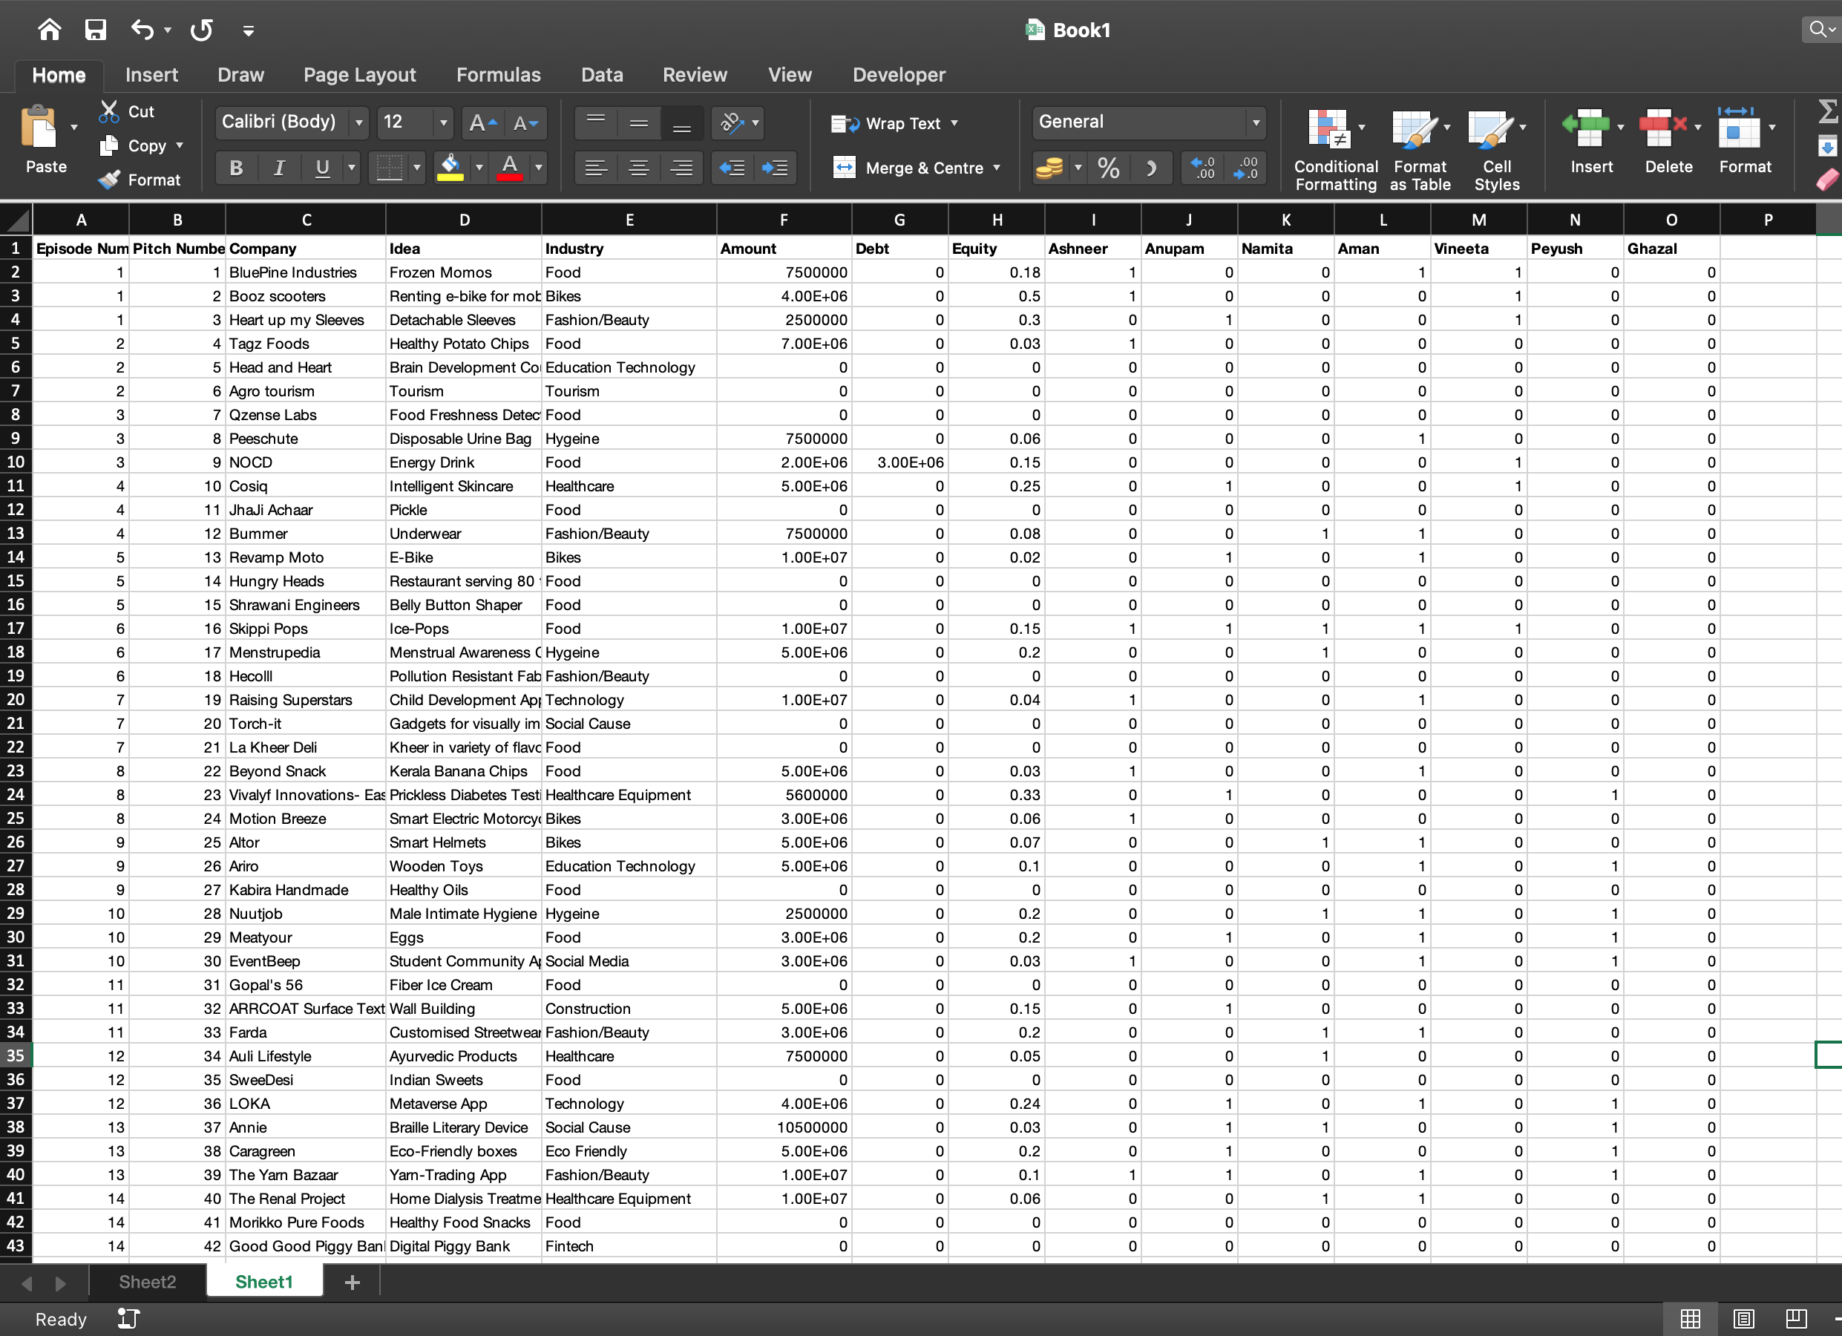
Shart tank india
We have a data of 118 companies, their sectors, investments made, ideas and episode numbers of Shark Tank India aired in the year 2021-22.
We aim to see if the investments made in particular industries are dependent on GDP growth of those companies.
Source: www.kaggle.com

Slide 8
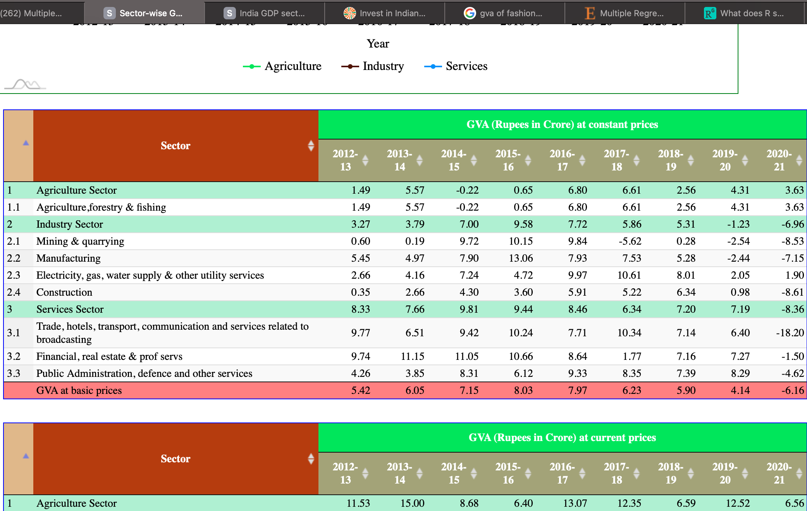
Sector Wise GDP Growth
For the same, we have taken sector-wise GDP Growth dataset and combined both the data sets to create a multiple regression model where Investments are the dependent variable whereas GDP growth in different years are independent variables.
Source: www.statistictimes.com

Slide 9
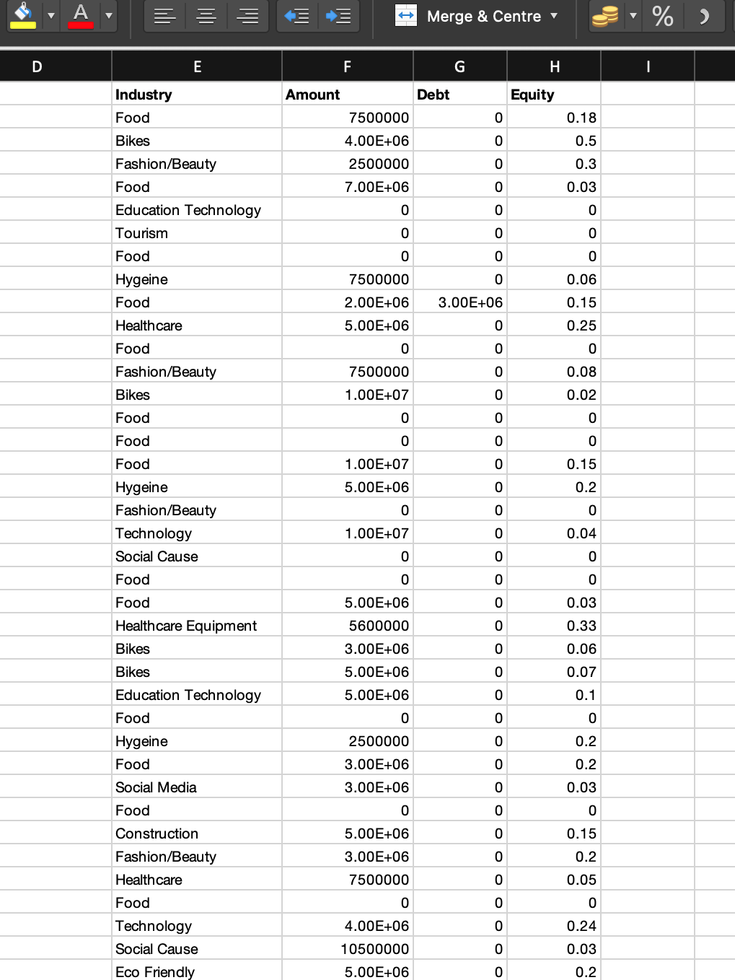
Data Cleaning
We don’t need:
Episode Number
Pitch number
Company
Idea
Debt
Equity
And individual investments

Slide 10
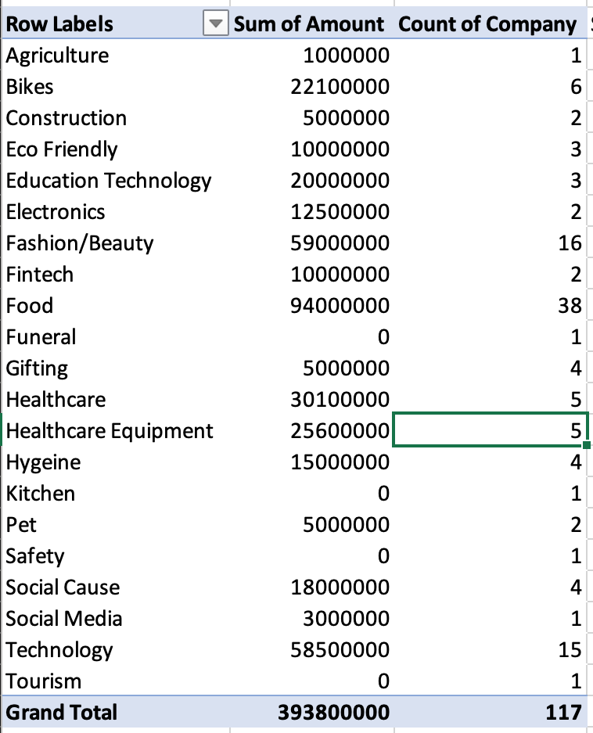
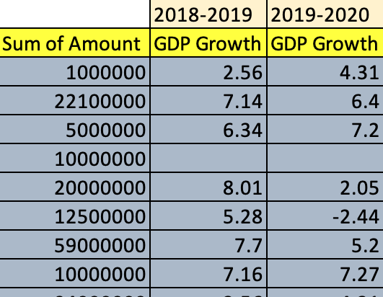
Data segragation
Using pivot table, we segregated the data in rows and columns. We put the values of sum of amount and count of companies in columns.
Sectors are classified.
Merging the data of the two datasets.
Clean the data with no information.

Slide 11
Data Analysis
Text
Using Data Analysis tool in excel, analysed the data with the regression model.
Taking amount invested as Y axis and GDP growth in year 2018-19 as X1 and 2019-20 as X2.
Analysing R, R square, F, and P values.
Let H0 be X1=X2=0 which would imply no relation.
Let H1 be X1 is not equal to 0 or X2 is not equal to 0 which would imply some relation.

Slide 12
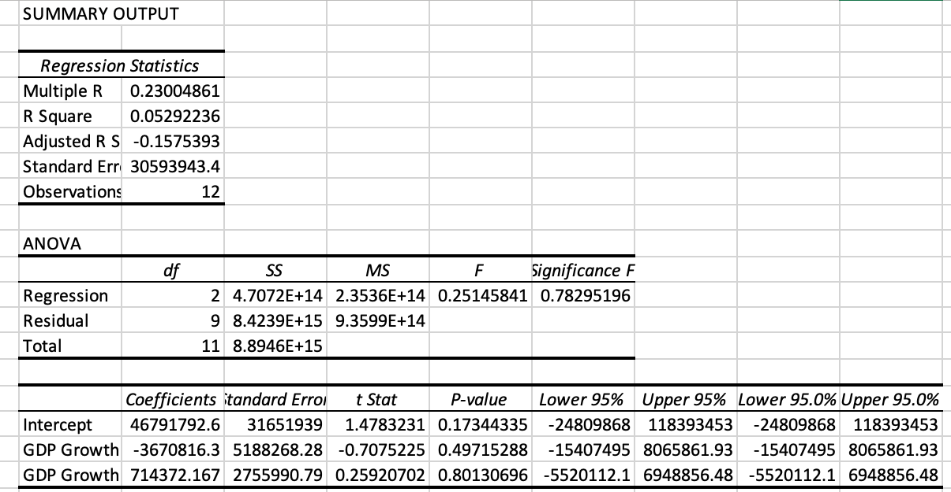
23% correlation
Denied

Slide 13
Conclusion
Text
Since the significance is much higher than 0.05, the relation we had aimed to prove is denied.
Hence, H0 is true. There is a very small or no relation between investment made and the GDP growth of those sectors.
P values are extremely high, which implies that investments have been made in ignorance of growth of any fiscal year.

Slide 14
Possible data analysis statements
Text
Start ups have been made in accordance to the potential growing sectors.
Investments have been made in accordance to the equity and debt.
Investments made in accordance to market sentiments.

